Slide 1

Implement a Serverless Data Analytics Strategy with Microsoft Azure
Roberto Freato

Slide 2
once upon a time, there was
A business intelligence team performing analysis and getting out insights
An entire company depending on those insights
A small but amazing dev/tech team in charge to build data stuff to do it
We didn’t know how fast would grow up
Didn’t want to overengineer
Didn’t know what a Data Platform was, either
Can you read this line?

Slide 3
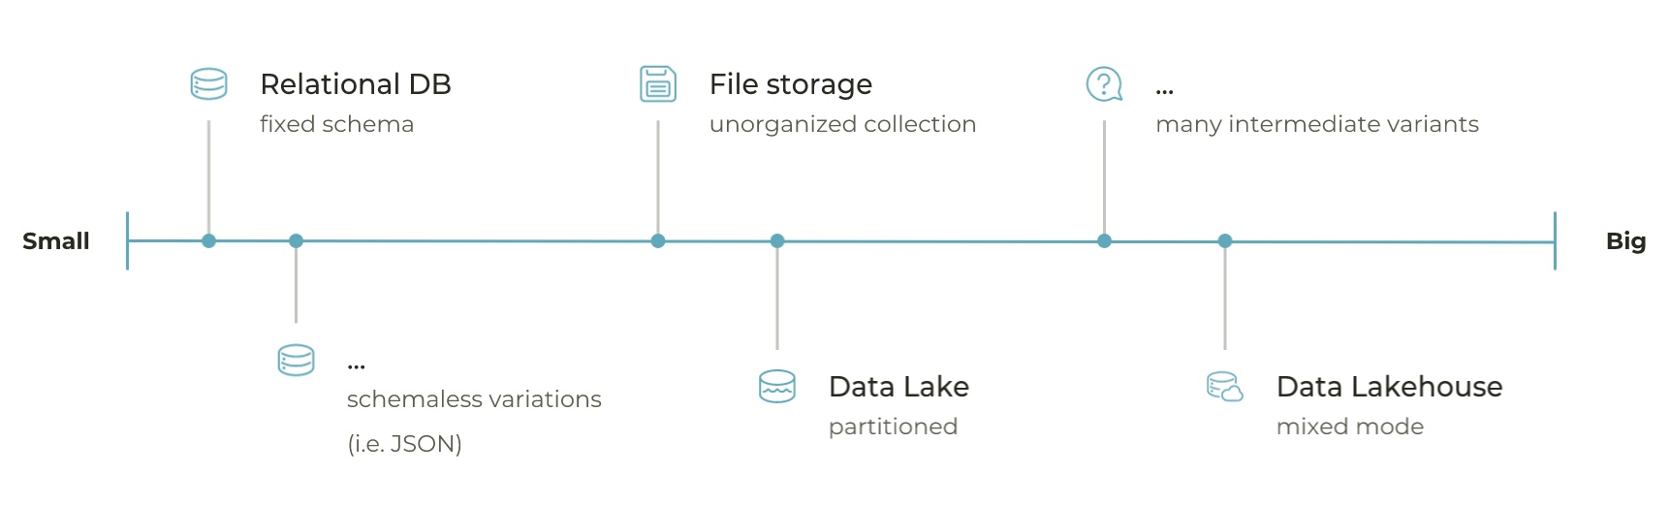
how we evolved and scaled the Data Platform
App Service
Batch
Container Instances
Container Apps
Even in the back seats?

Slide 4
some glossary
Data Movement
Data Platform
Landing Storage
Big Data
Spark
Sourcing
Ingestion layer
Data Engineering
Databricks
Cloud
And now?

Slide 5



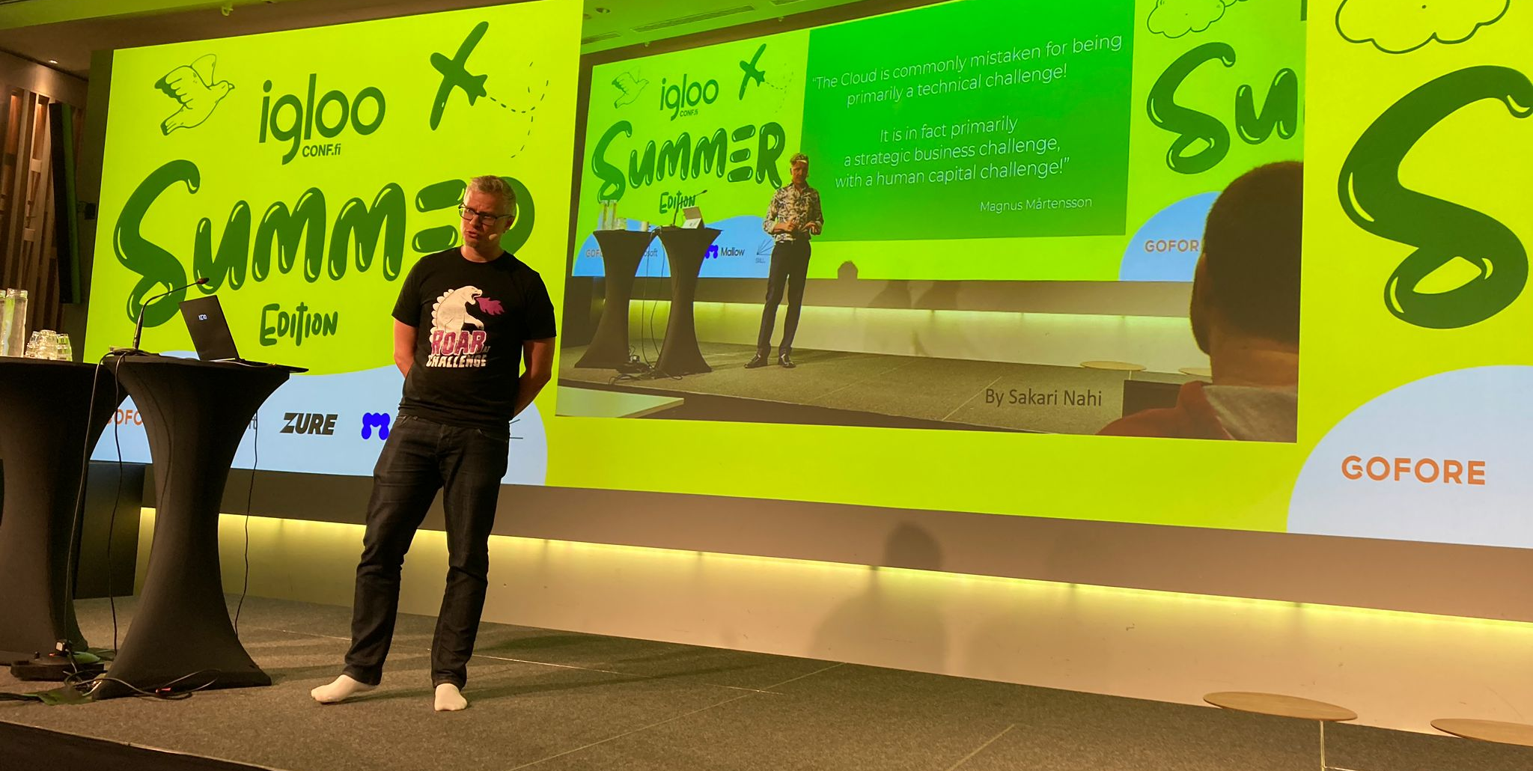

Slide 6
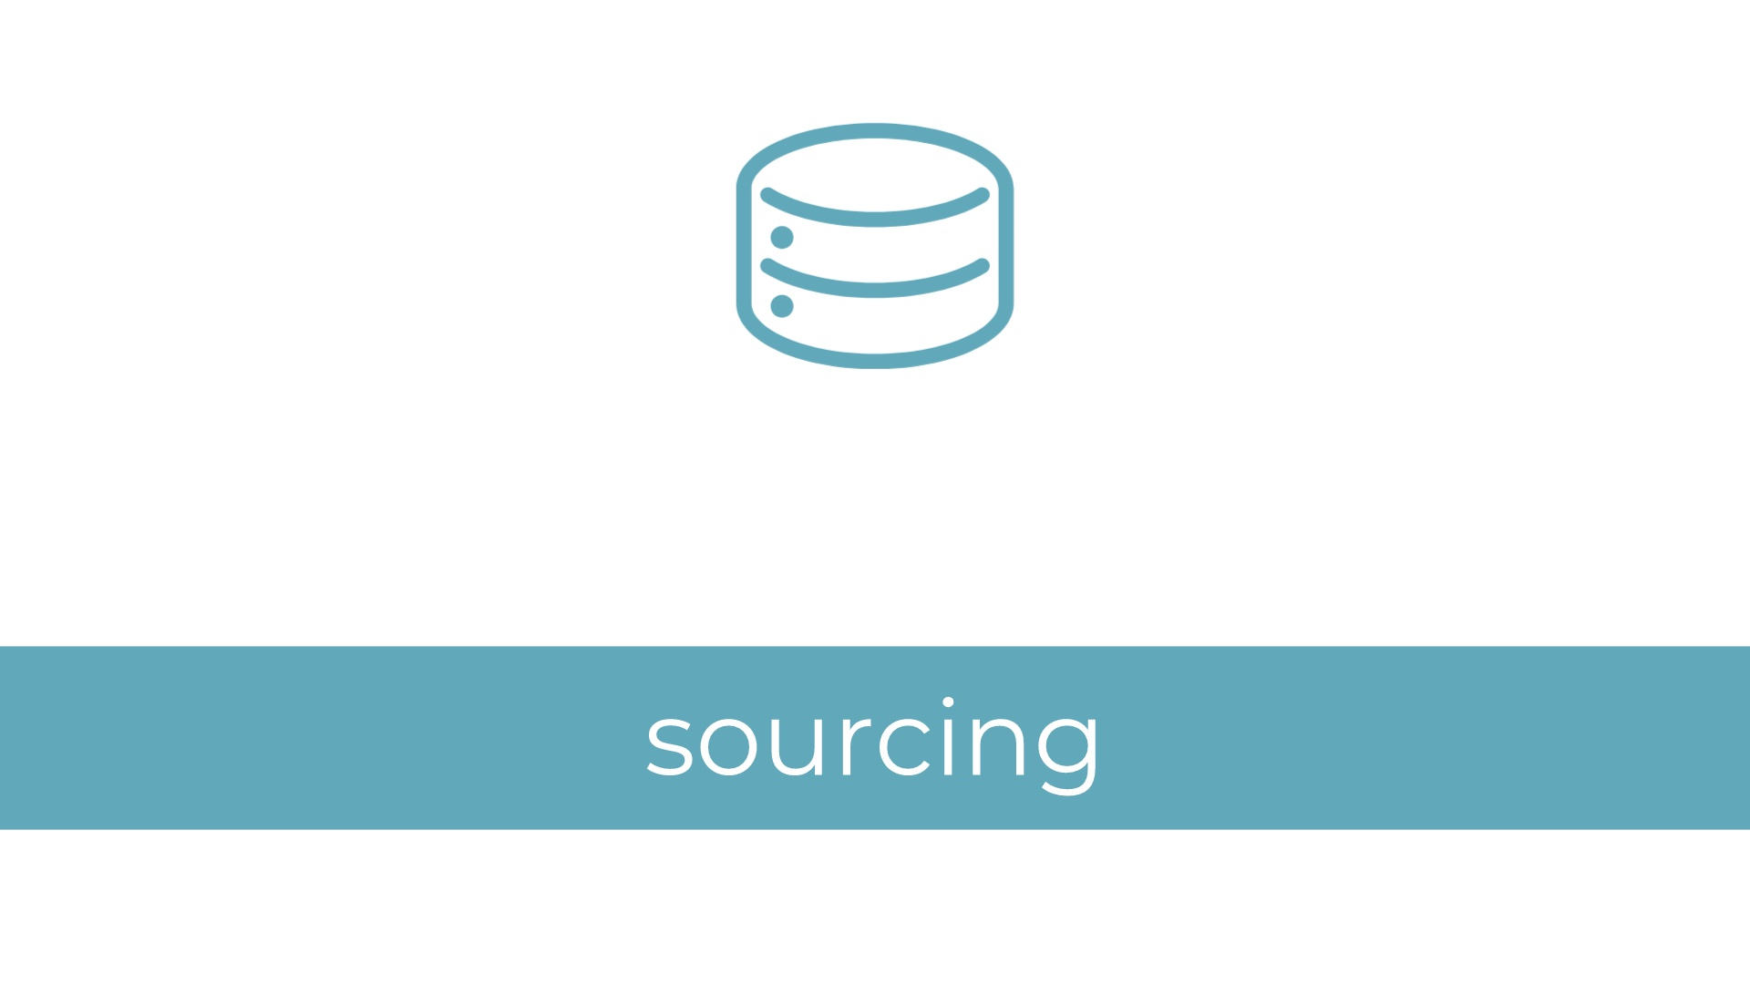

Slide 7
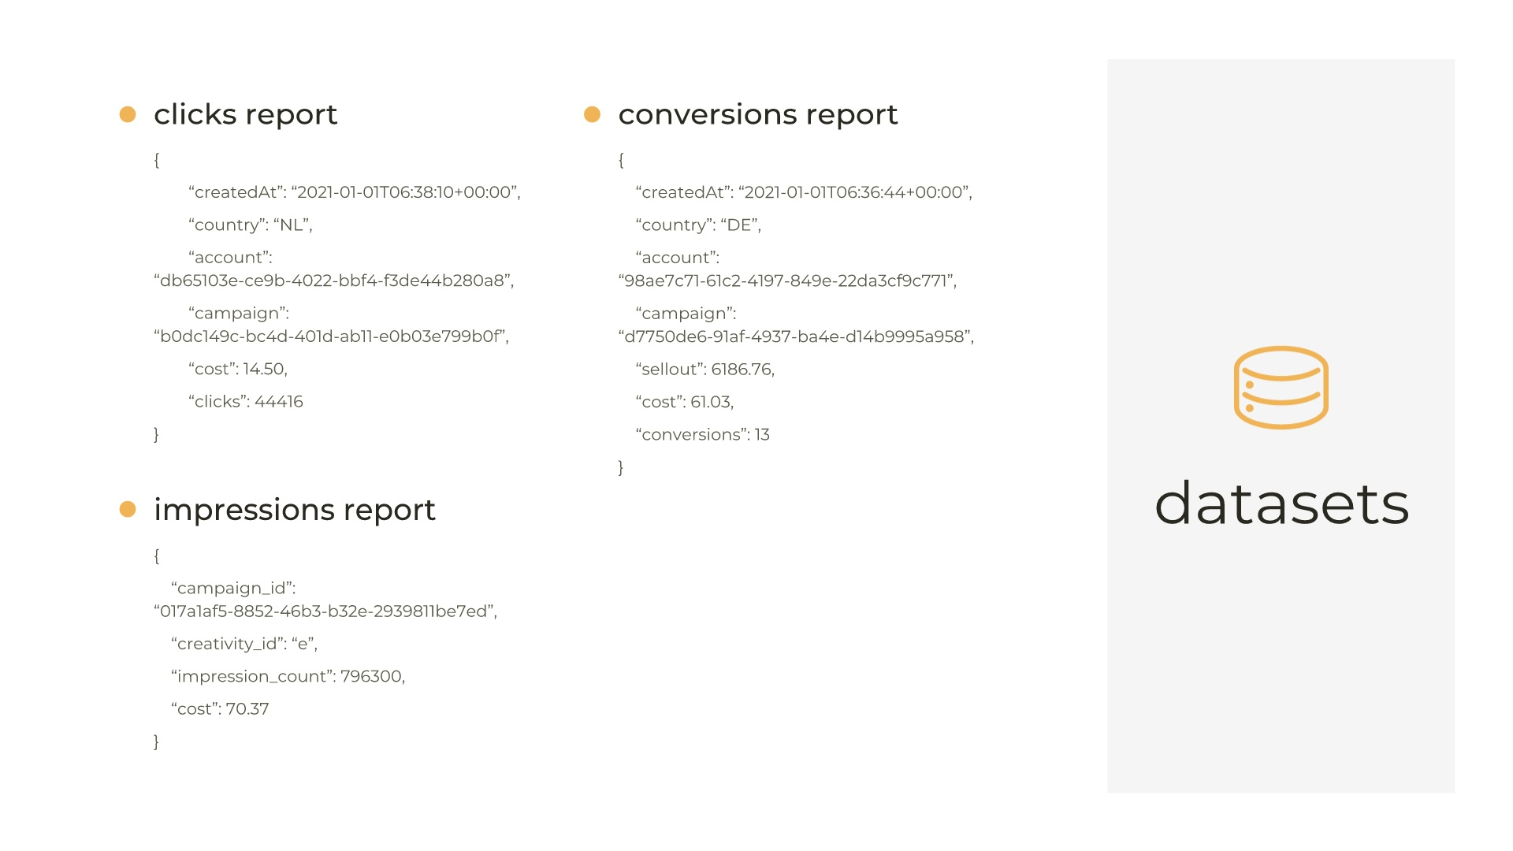

Slide 8
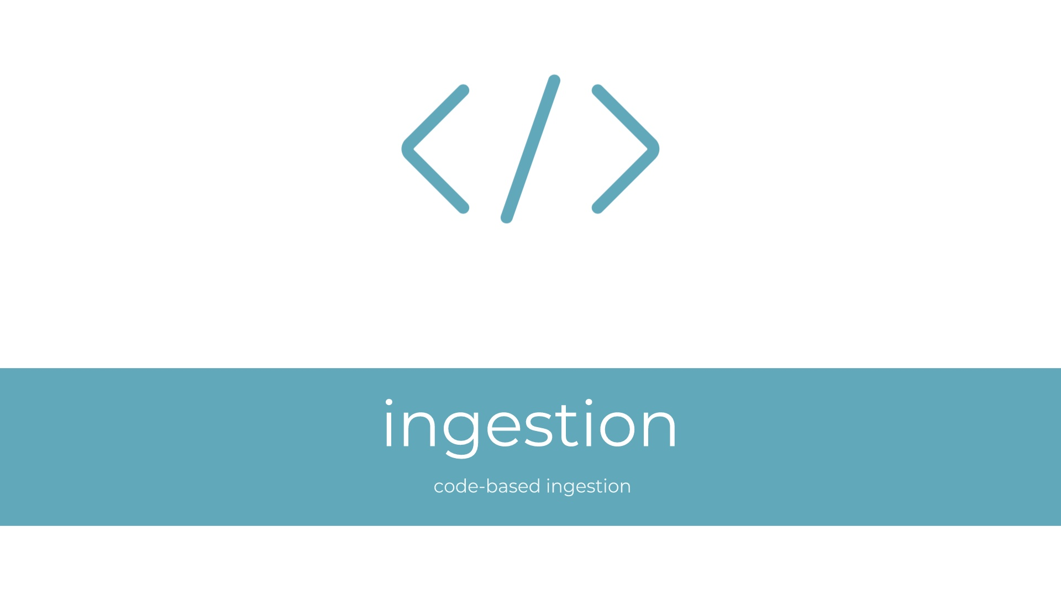

Slide 9
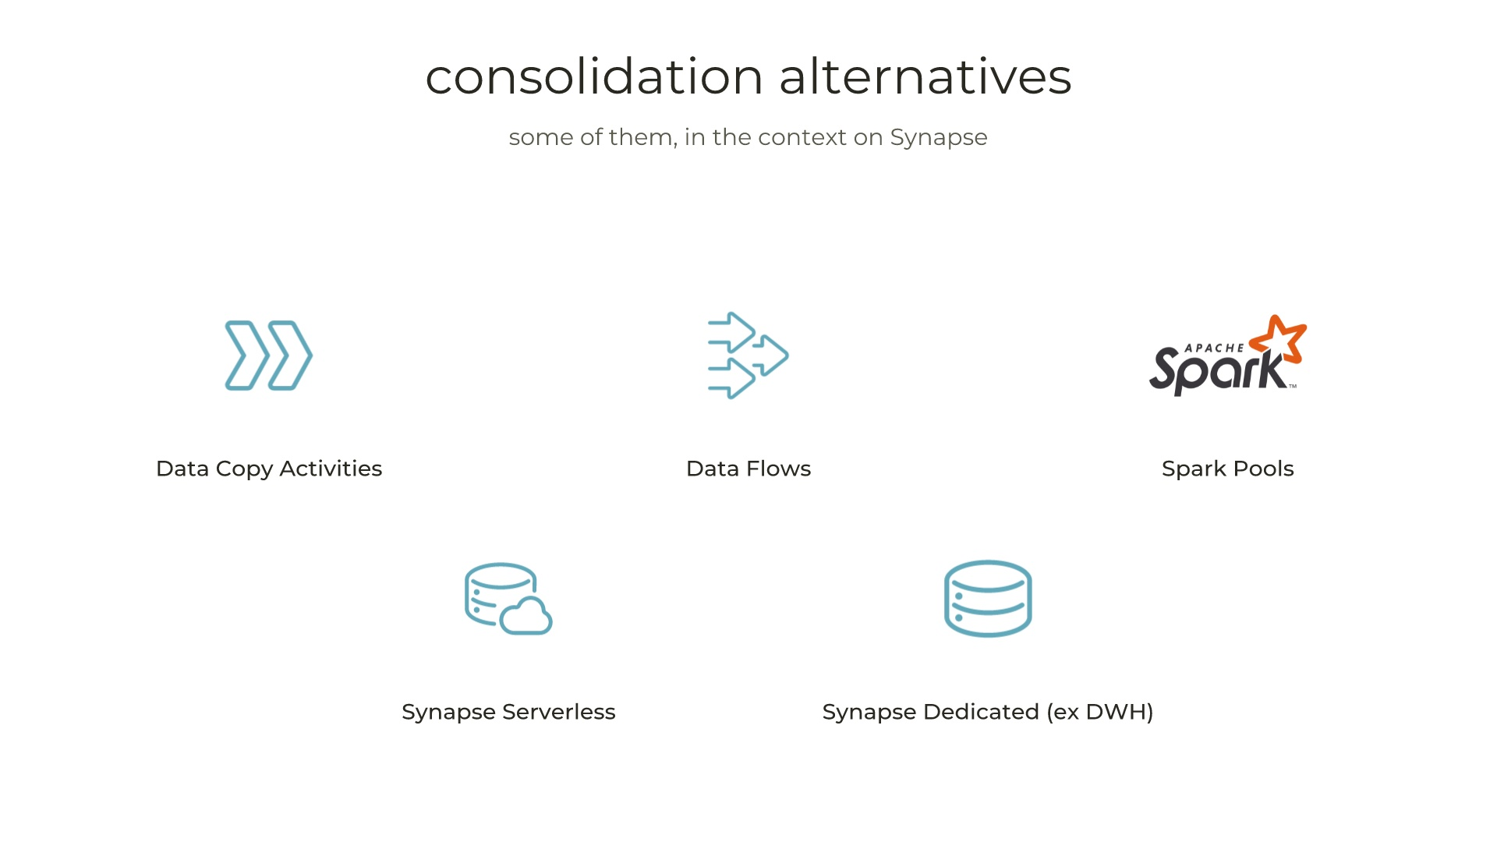

Slide 10
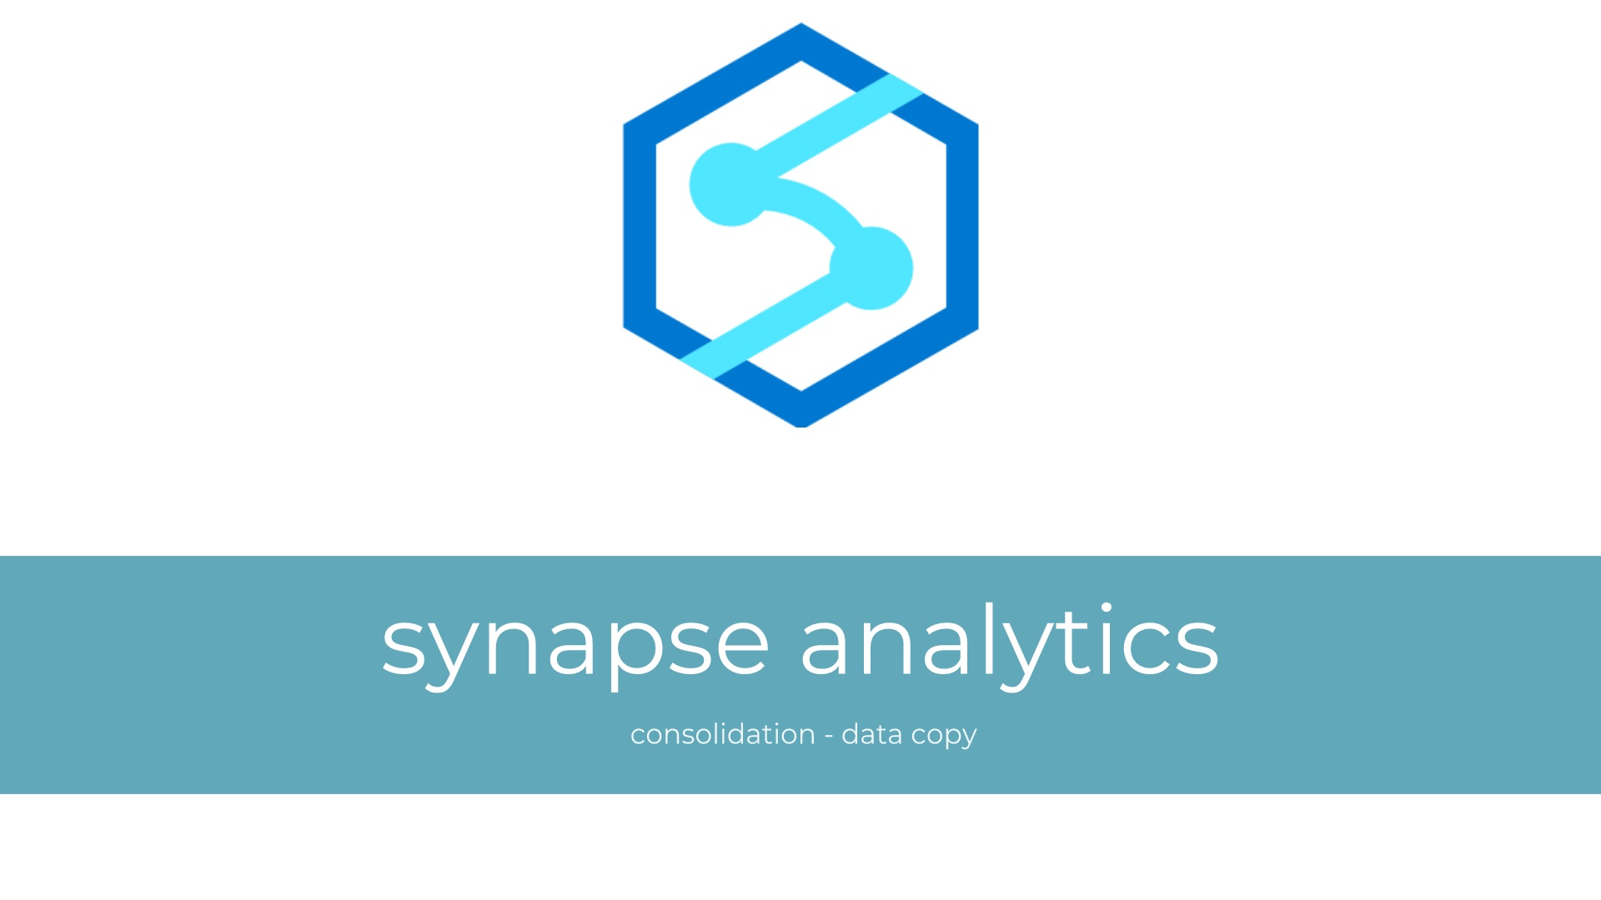

Slide 11
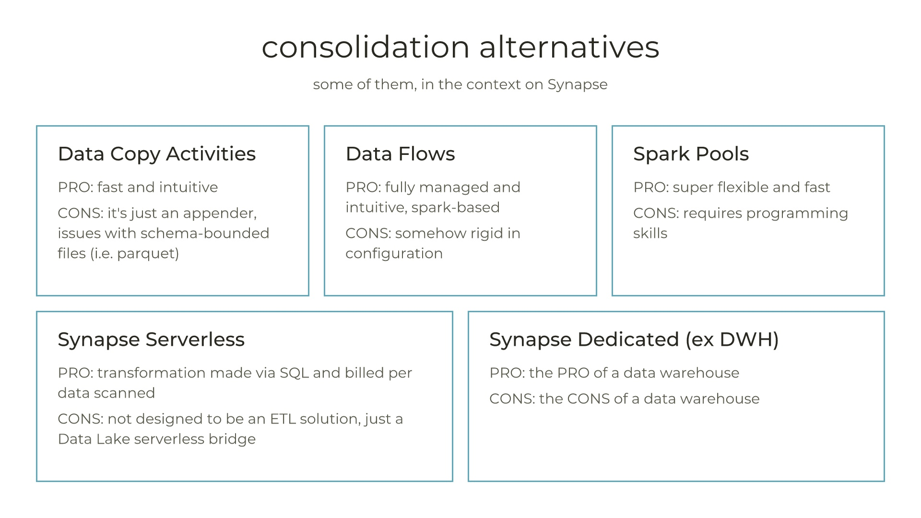

Slide 12
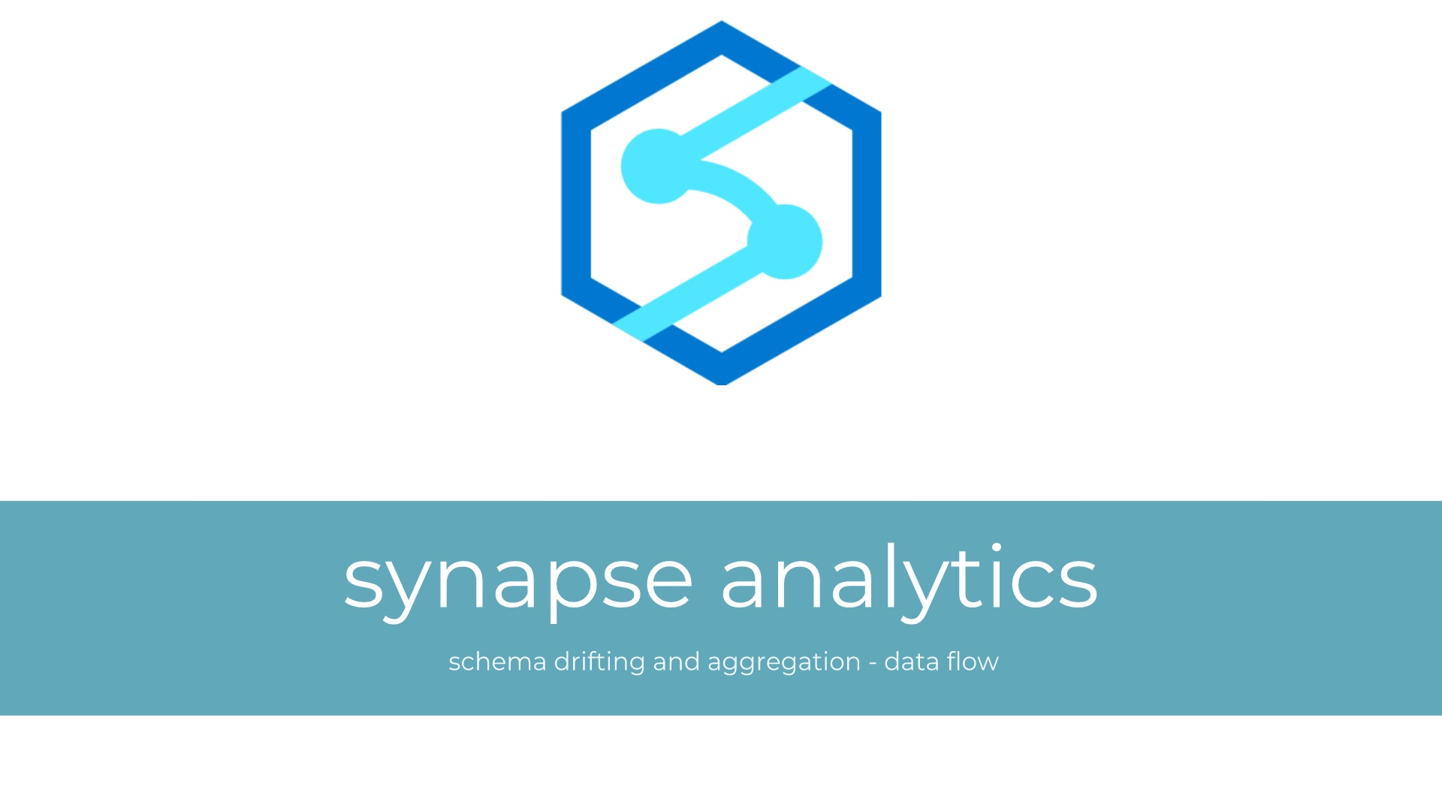

Slide 14


Slide 15
how we evolved and scaled the Data Platform
App Service
Batch
Container Instances
Container Apps
Even in the back seats?

Slide 16
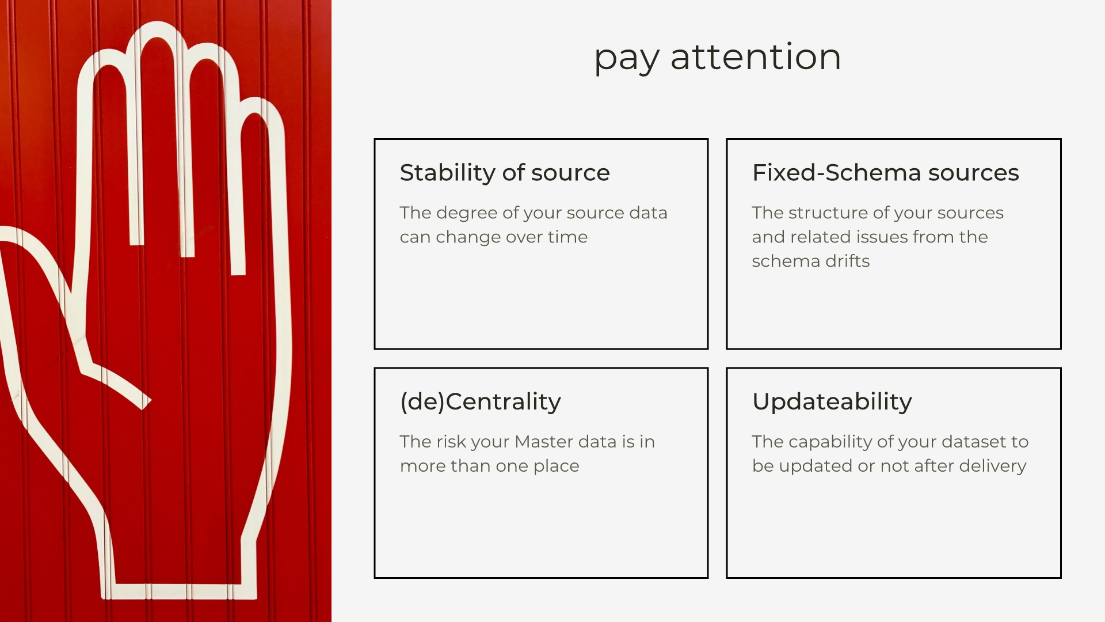

Slide 17
Thank you
Roberto Freato

